Slide 1
UTAH ACP 2026
March 12, 2026
Obesity-Related Respiratory Failure
O₂ →
Pulmonary
Circulation
Muscle
What it is, who has it, & why the discharge is so hard
← CO₂ buildup
Brian W Locke MD MSCI
Pulmonary & Critical Care Medicine, Intermountain Medical Center
COI: Mountain Biometrics (automated data harmonization) — unrelated to this work
Funding:
ATS ASPIRE Fellowship
NIH NHLBI T32 — University of Utah PCCM
Intermountain PCCM Seed Grant: FUND-Hypercapnia
Utah Population Database via HCI & HCI Cancer Center Support Grant P30 CA2014
adapted from Wasserman et al.
Notes:
Transcript of the talk: (dictated, forgive errors)
My name is Brian Locke. I’m an assistant professor working in the Shock Trauma ICU and the Schmidt Chest Clinic, and today I’m giving an update on hypercapnic respiratory failure. I have a conflict of interest with a local startup doing machine learning unrelated to this talk. I want to acknowledge support from the American Thoracic Society, the NIH, and our Pulmonary and Critical Care Medicine seed grant, and to thank the Utah Population Database and its funders. For those following along in NotebookLM, Google’s large language model environment, I’ve uploaded key literature so you can query or review the synthesized notes while we go.
I’ll start with background and the current state of hypercapnic respiratory failure, move to what we’re doing clinically and in research, and end with new CMS national coverage determinations for respiratory assist devices and home mechanical ventilators—changes most private payers will soon mirror—so we can discuss how to qualify patients for devices.
First, definitions. Hypercapnic respiratory failure is a syndrome—the pattern of signs and symptoms that accompany a CO₂ level that is too high—reflecting failed homeostasis: an imbalance between tissue CO₂ production and alveolar ventilation that allows PaCO₂ to rise. Hypercapnia itself is a finding defined against the distribution of normal values. Because “normal” shifts with altitude, the threshold for abnormality is lower here than at sea level; using 41–42 mmHg in Salt Lake City is appropriate. Payers don’t adjust coverage criteria for elevation, which may not matter for borderline cases clinically, but it matters for how we interpret a clinic PaCO₂ of 43–44 mmHg locally—that’s abnormal. Although one might imagine adding criteria (for example, excluding cases where elevated PaCO₂ is a proportional response to metabolic alkalosis—what I’d call “respiratory success”), TriNetX data suggest isolated, compensatory hypercapnia is rare. In practice, the syndrome is defined by a high CO₂.
I prefer the term ventilatory failure because homeostasis can fail without overt hypercapnia when the physiologic context calls for a lower PaCO₂. The framework I use is supply versus demand: can the patient sustain the ventilation the situation requires? Demand depends on three variables: the dead-space fraction (the portion of each breath wasted for CO₂ exchange), tissue CO₂ production, and the target PaCO₂ appropriate to the situation. If dead space increases, required ventilation rises. If CO₂ production rises, required ventilation rises proportionally. If the target PaCO₂ is lower, required ventilation climbs nonlinearly.
Supply—the maximal sustainable ventilation—depends on respiratory muscle capacity and mechanical advantage, the stability of respiratory control, and the loads on the system. Loads include resistive loads (like breathing through a straw), elastic loads (inflating a stiff lung or chest wall), and, in many acute settings, threshold and inertial loads. Opioids and sleep alter control stability; COPD with hyperinflation, neuromuscular disease, and pleural or chest wall disease alter mechanics. Patients whose chronic loads push them close to their sustainable limit have little physiologic reserve. Think of a person with COPD whose FEV₁ is well under a liter: a small increase in demand can precipitate failure. Those are the patients who need close attention, as highlighted by prior work in this area.
It’s worth dwelling on the goal PaCO₂. Mathematically, a higher PaCO₂ target lowers required ventilation, which can seem counterintuitive. Elevated CO₂ signals a response to some underlying stress, but from a mechanics standpoint, higher alveolar CO₂ allows each exhaled breath to carry a higher CO₂ concentration, reducing the total ventilation needed to maintain steady state. That’s the rationale for permissive hypercapnia in lung-protective ventilation: allowing PaCO₂ to rise lets us reduce ventilatory pressures. Evidence from ECMO cohorts and from patients with kidney injury suggests that for a given CO₂ rise, lack of metabolic compensation portends worse outcomes in ARDS, partly reflecting multi-organ failure and partly the ongoing mechanical stress on lungs. This raises a question: if higher PaCO₂ lowers ventilatory work and pH can be maintained at any PaCO₂ with sufficient bicarbonate, why isn’t the set point much higher—why not a PaCO₂ of 90 with a bicarbonate of 45? The answer likely lies in oxygen. By the alveolar gas equation, CO₂ “occupies space” that would otherwise contribute to alveolar oxygen; at room air (FiO₂ 0.21), a higher PaCO₂ erodes the oxygenation buffer. The transition from acute to chronic hypercapnia seems to involve a control-system calculation that balances the effort of breathing against the cost of reduced oxygen margin. In chronic respiratory failure, the old “can’t breathe/won’t breathe” dichotomy doesn’t help.
Severe hypercapnia as a survivable state is relatively new in medicine. Before supplemental oxygen, significant hypercapnia generally meant death. Only about 75 years ago did clinicians begin to recognize and treat it. Hannah Wunsch’s The Autumn Ghost recounts how, during the early polio epidemics, somnolence and unresponsiveness were attributed to encephalitis (“cerebrelia”) until clinicians provided manual positive-pressure breaths and patients woke up—revealing CO₂ retention as the true cause and inaugurating modern critical care.
I argue that hypercapnic respiratory failure management is a large, solvable, and neglected problem. On scale: an Australian study in the Blue Journal estimated a population-standardized period prevalence of PaCO₂ ≥45 mmHg (excluding iatrogenic causes) of 150 per 100,000 person-years—higher than decompensated cirrhosis in the United States, which is roughly 100 per 100,000. A limitation is that not every patient with hypercapnia gets a blood gas, so ascertainment is imperfect. The only study I know that checked blood gases without clinical indication—a 2005 Denver VA study of consecutive admissions with BMI ≥35—found elevation-adjusted hypercapnia in about a third of patients, with only about one in ten recognized clinically.
Our group used the Utah Population Database to estimate pre‑COVID yearly period prevalence of ICD codes for hypercapnic respiratory failure in Utah; there were about 4,000–5,000 codes per year across five primary codes, which normalizes to roughly 150 per 100,000—again, in that same ballpark. TriNetX analyses help interpret this: among patients with hypercapnia on blood gas, about a third in the ED and about 40% in inpatient settings receive an ICD code for hypercapnic respiratory failure, suggesting code-based counts may underestimate the true burden by up to a factor of three.
Outcomes are concerning across etiologies. A single-center study from Vermont of inpatients with an ICD code for hypercapnic respiratory failure showed a 30‑day readmission rate of about 25%, similar to heart failure and higher than myocardial infarction, with two-thirds readmitted for recurrent hypercapnia. In the Michigan health system, even compensated hypercapnia on blood gas was associated with increased mortality; a PaCO₂ in the 50–65 mmHg range carried a risk roughly comparable to decompensated cirrhosis, with higher PaCO₂ worse and milder elevations somewhat better. In TriNetX data, among about 30,000 patients with hypercapnic respiratory failure codes (mean age ~65), two‑month mortality was 20% and climbed to about 30% by nine months.
These patients are also expensive to care for. Office of Inspector General reports document dramatic growth in use of home mechanical ventilators and noninvasive respiratory assist devices beginning around 2013, with more than a hundred‑fold increases relative to 2009 baselines. Comprehensive cost estimates are lacking, which is why one of our first seed‑grant projects is an economic analysis linking Intermountain Health records to Select Health claims. We call this AIM‑HIGH (Artificial Intelligence for Modifiable Health Indicators in Groups with High Needs), starting with hypercapnic respiratory failure and extending to other high‑utilization conditions, using machine learning to identify patients at risk and intervene.
Therapeutic options exist, although the evidence base is uneven. Guidelines for obesity hypoventilation recommend treatment despite surprisingly low levels of evidence. There are randomized trials in neuromuscular weakness (and in cystic fibrosis, though not discussed today), and there is a dozen‑plus trials of long‑term noninvasive ventilation in chronic stable hypercapnic respiratory failure that are generally supportive when done appropriately. It is not all NIV. Weight‑loss interventions matter for the sleep‑disordered breathing component of hypercapnia. The FDA has approved tirzepatide for obstructive sleep apnea, and our meta‑analysis shows a dose‑dependent improvement in OSA with both surgical and medical weight loss. Although we don’t yet know the exact fraction of hypercapnia attributable to sleep apnea, several cohorts that systematically tested ICU survivors of hypercapnic respiratory failure found that the majority had moderate to severe OSA. Even outside strict OHS definitions, sleep apnea likely plays a substantial causal role that we systematically miss without testing.
These needs have prompted a movement to formalize a subspecialty in chronic respiratory failure. An AnnalsATS piece last year makes the case: roughly 300 clinicians nationwide specialize in managing chronic respiratory failure—far too few for current needs—and care requires both device expertise and structured processes around DME ordering and respiratory therapy support. Subspecialty designation could solidify a research paradigm and allow us to advocate for structural changes.
Two evidence gaps hinder effective care. First, real patients usually have multiple contributing causes for hypercapnia, but most trials target single‑cause cohorts. Trials of hypercapnic COPD often enroll patients with average BMIs around 25 and exclude comorbid sleep apnea; the definition of OHS, in turn, excludes patients with even modest contributions from heart failure or COPD. What should we do for someone with COPD, heart failure, and sleep‑disordered breathing? The evidence rarely applies cleanly, so we extrapolate. Second, the evidence presupposes a definitive diagnosis, whereas in practice hypercapnic respiratory failure often precedes the diagnosis of the causative condition. Patients are admitted without prior spirometry, sleep testing, or sometimes even an established outpatient relationship; they’re stabilized and discharged; testing is ordered but often not completed; and care transitions create opportunities to fall through the cracks.
We examined statewide testing patterns using the Utah Population Database and the All‑Payer Claims Database (covering ~90% of commercially insured patients and ~70% of other care from 2015–2019). Among patients with inpatient or ED encounters coded for hypercapnic respiratory failure, roughly two‑thirds had an echocardiogram in the five years before the index event, but only about one in three had spirometry and about one in five had sleep testing. In the year after the event—including the index hospitalization—about half received an echocardiogram, but only ~one in eight had spirometry and ~one in ten had sleep testing. These figures likely underestimate testing only slightly (e.g., in‑migrants), and they underscore a system‑level gap. Our CO₂‑PATH cohort (Post‑Acute Trajectories of Hypercapnia) is designed to define the denominator rigorously, follow trajectories after discharge, benchmark testing and outcomes across the state, and, crucially, help distinguish frailty markers from ventilatory targets that can alter risk.
The usual post‑discharge workflow helps explain low completion rates. An inpatient team prescribes a home mechanical ventilator; the DME company receives the order and sends a respiratory therapist to set up equipment and educate the family; referrals go to PDNs and to pulmonary clinic; PFTs are typically ordered before the pulmonary visit; sleep referrals are placed and often misunderstood by patients who presented with daytime dyspnea. Many steps occur before any specialist discussion, and each step can derail. This argues for two parallel efforts: measure how the system is performing now (CO₂‑PATH) and move toward risk‑based referrals and early empiric management when indicated.
Based on ICD counts, I estimate 5,000–6,000 hypercapnic respiratory failure cases present to acute care or ED settings within Intermountain annually. Not all require specialty care—some are transient, iatrogenic, or manageable in primary or general pulmonary care—but we need to identify the subset at high risk of readmission if we don’t intervene. AIM‑HIGH, which links Intermountain clinical data with Select Health claims, is designed to stratify that risk and target resources.
In the Schmidt Clinic, I spend most of my time managing chronic respiratory failure. Our three main referral streams are high‑risk post‑discharge patients via the pulmonary disease navigators (Claire Davies and Megan Hepworth), internal referrals for potential NIV starts, and a neuromuscular clinic. We don’t have an ALS center at Intermountain, so those patients go to the university, but other neuromuscular patients come to our clinic. We could accept more referrals from PM&R, post‑acute facilities, and patients initially triaged to sleep clinics for suspected OHS who are ultimately determined not to have a primary sleep‑breathing disorder. Much of this care can be handled remotely. Device downloads provide rich information; paired with video visits, we can deliver high‑fidelity care and potentially expand our geographic reach.
To close, I want to clarify device categories and the new coverage rules. “Respiratory assist device” is a term coined when CPAP for sleep apnea and hospital ventilators had distinct roles; CMS wanted to avoid paying for home ventilators for the entire sleep apnea population. The community adopted “RAD” to signal that these were not ventilators. The technology has matured: modern RADs can do bilevel, backup rates, and volume‑assured pressure support (volume‑targeted pressure support). Some capabilities still require a home mechanical ventilator, such as AVAPS‑AE (volume assurance with adjustable EPAP) and other advanced modes used in severe disease. RADs typically cap maximum inspiratory pressures around 30 cm H₂O, which sounds high until you recall that contemporary COPD NIV trials have mean IPAPs in the mid‑20s and about a quarter of patients above 30. RAD settings can be changed remotely; HMV settings generally cannot. RADs are capped‑rental and eventually owned by the patient; HMVs fall under frequent‑and‑substantial‑servicing rental and include bundled respiratory therapy support.
Historically, RAD qualification pathways were fragmented (restrictive thoracic disorders, hypercapnic COPD, hypoventilation), with requirements that often didn’t match the indication—for example, obligate nocturnal hypoxemia in COPD candidates. CMS recently approved a new national coverage determination. Neuromuscular criteria are unchanged: a qualifying diagnosis plus either hypercapnia, nocturnal hypoxemia, or spirometry criteria. The COPD bucket is now effectively “all chronic respiratory failure,” which is confusing but pragmatic. There are two paths: outpatient and discharge. The outpatient path doesn’t require PFTs; it does require stable daytime PaCO₂ ≥52 mmHg and a determination that sleep apnea isn’t the sole cause (not necessarily proven by polysomnography or nocturnal oximetry). The discharge path requires full RAD settings documented within 24 hours of discharge and a clinical judgment that the device is needed to avoid symptoms or rapid CO₂ rise. Both paths now include re‑qualification every six months, including average use of at least five hours per 24 hours and documented improvement in CO₂, exacerbations, or symptoms—which will increase clinic volume and require workflow adjustments.
HMV previously had an easier bar: a qualifying condition plus a statement that interruption of support would quickly lead to serious harm or death. That disparity helped drive HMV use upward, not always because patients needed ventilators, but because RAD qualification was onerous. Under the updated rules, neuromuscular indications for HMV are unchanged. For non‑neuromuscular chronic respiratory failure, the outpatient path now requires meeting RAD criteria plus at least one additional need (an advanced mode, higher IPAP requirements, or failure of RAD), and in our setting, oxygen needs above roughly 36% (about 4 L/min) can also support the case when combined with one of those criteria. The discharge path hinges on documented inpatient use of the HMV within 24 hours and capabilities that exceed what a RAD can provide, with full settings documented. Ongoing follow‑up requirements align with those for RADs.
If you’re interested in collaborating on hypercapnia research, have ideas about referrals, or want to discuss specific patients, please reach out in the EHR (soon via Epic) or by email. This is a team effort: our pulmonary disease navigators, Claire Davies and Megan Hepworth, do a tremendous amount of the day‑to‑day work, and our research partners span Intermountain, Select Health, the University of Utah, and UC Davis. I’m happy to take questions.

Slide 2
Learning Objectives
01 | Define obesity hypoventilation syndrome and explain why "obesity-related respiratory failure" may be a more useful clinical framework
02 | Identify patients at risk for obesity-related respiratory failure — including common misdiagnoses
03 | Explain why discharging patients on BPAP is so difficult — including the historical and regulatory origins of device categories, qualification pathways, and payment structure
04 | Discuss the emerging role of GLP-1 receptor agonists in obesity-related respiratory failure

Slide 3
Obesity Hypoventilation Syndrome (OHS)
Textbook definition requires ALL of: (know this for exams)
Obesity (BMI ≥ 30 kg/m²)
Daytime hypercapnia (PaCO₂ ≥ 45 mmHg at sea level)
Sleep-disordered breathing (OSA or sleep hypoventilation)
Exclusion of other causes of hypoventilation
Those last two criteria are the problem in practice...

Slide 4
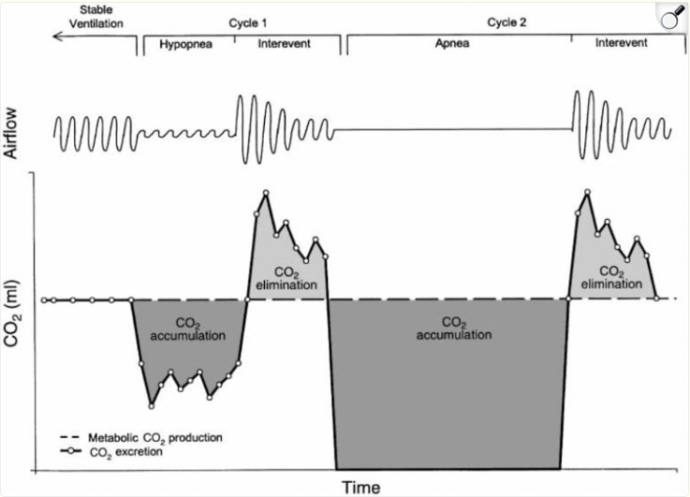
Requirement of Sleep Disordered Breathing?
Either:
OSA (AHI over 5 /hr and symptoms, or 15/hr)
Sleep Hypoventilation (10 cmH₂O rise of nocturnal CO₂ over 55 mmHg)
Does it matter? No
If hypothetically, someone w/ BMI of 40 kg/m2 has an AHI of 4 and nocturnal CO₂ of 52 and daytime of 47… would they not have OHS?
How OSA Contributes to Hypercapnia
Berger et al, J Appl Physiol 88:257-264 (2000)

Slide 5
Exclusion of Other Causes Is Problematic
Person at Timepoint A:
Multi-Causal Model
BMI 40, AHI 15, ABG 7.45/50 (pCO₂)
All Recognized Cases (inc. multifactorial)
Person at Timepoint B:
Same values + H₂FPEF score suggesting HFpEF
COPD
???
Obesity Hypovent.
Did we just cure their OHS?
Obviously not.
Operationalize this as "Is obesity having a substantial causal contribution to this patient’s hypercapnia?", not the exclusion of other causes.
HFpEF
Disease contributions overlap & vary
Patient A
Patient B
■ Obesity ■ HFpEF ■ Unknown
Key: Obesity is a causal contributor — not defined by exclusion of other causes

Slide 6
A more useful mental model:
"Obesity-Related Respiratory Failure"
Obesity is a primary driver of the respiratory failure, regardless of comorbidities
Better management implications

Slide 7
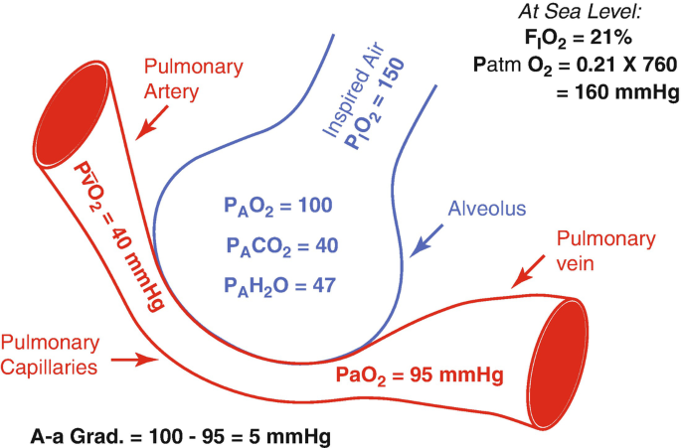
MOC Question
In a 65-year-old patient with normally functioning lungs (normal A–a gradient of 10 mmHg) breathing room air (FiO₂ 0.21) at Salt Lake City elevation (~4,000 ft; P_{b} 656 mmHg), using the simplified alveolar gas equation (PH₂O 47 mmHg, RQ 0.8):
To what approximate PaCO₂ would it need to rise before SpO₂ drops below 90% (PaO₂ ~60 mmHg)?
A. 45 mmHg
B. 55 mmHg
C. 65 mmHg
D. 75 mmHg
E. 85 mmHg
Recall: P_{A}O₂ = FiO₂ × (P_{b} − PH₂O) − (PaCO₂ / RQ) O₂ is 17.8 mmHg lower at 4,500 ft
Notes:
MOC Question:
In a 65-year-old patient with normally functioning lungs (assume a normal A–a gradient of 10 mmHg) who is breathing room air (FiO2 0.21) at Salt Lake City elevation (~4,000 ft; standard barometric pressure 656 mmHg. Using the simplified alveolar gas equation with PH2O 47 mmHg and respiratory quotient (RQ) 0.8), to what approximate PaCO2 would it need to rise before SpO2 is expected to drop below 90% (generally occurs when PaO2 is ~60 mmHg)?
A. 45 mmHg
B. 55 mmHg
C. 65 mmHg
D. 75 mmHg
E. 85 mmHg
Correct answer: A. 45 mmHg
Rationale (with the math)
Link SpO2 threshold to PaO2 threshold
An SpO2 of ~90% corresponds to a PaO2 of ~60 mmHg on the standard oxyhemoglobin dissociation curve.
At 4,000 feet, standard barometric pressure is ≈ 656 mmHg
Calculate inspired (humidified) oxygen partial pressure (PiO2)
PiO2 = FiO2 × (Pb − PH2O)
PiO2 = 0.21 × (656 − 47)
PiO2 = 0.21 × 609
PiO2 ≈ 128 mmHg
Use the simplified alveolar gas equation (normal lungs: PaCO2 ≈ PACO2)
PAO2 = FiO2 × (Pb − PH2O) − (PaCO2 / RQ)
So, at this altitude on room air:
PAO2 ≈ 128 − (PaCO2 / 0.8)
PAO2 ≈ 128 − 1.25 × PaCO2
Convert PaO2 target (60 mmHg) into an alveolar (PAO2) target using the assumed normal A–a gradient
PaO2 = PAO2 − (A–a)
60 = PAO2 − 10
Therefore, PAO2 ≈ 70 mmHg
Solve for PaCO2 at the point where PAO2 ≈ 70 mmHg
70 = 128 − (PaCO2 / 0.8)
PaCO2 / 0.8 = 128 − 70 = 58
PaCO2 = 58 × 0.8 = 46.4 mmHg
Conclusion: PaCO2 would need to rise to ~46 mmHg for SpO2 to be expected to fall below 90%, given the stated assumptions. At our elevation, even mild elevations in PaCO2 lead to hypoxemia, regardless whether additional lung pathology is present.
References
Hendrix JM, Burns B. Alveolar Gas Equation. StatPearls [Internet]. Updated Sep 11, 2024.

Slide 8
Hypercapnia in SLC
✓ Correct: A. ~45 mmHg
1 SpO₂ → PaO₂ SpO₂ ~90% ≈ PaO₂ ~60 mmHg
2 PiO₂ at altitude PiO₂ = 0.21 × (656 − 47) = 128 mmHg
3 Alveolar gas eq. P_{A}O₂ = 128 − 1.25 × PaCO₂
Target: PaO₂ = P_{A}O₂ − 10 = 60 → P_{A}O₂ = 70 mmHg
4 Solve for PaCO₂ 70 = 128 − (PaCO₂ / 0.8)
PaCO₂ / 0.8 = 58 → PaCO₂ ≈ 46 mmHg
Clinical takeaway: At our elevation, even mild elevations in PaCO₂ lead to hypoxemia — regardless of additional lung pathology.
Normal PaCO₂ of 40 mmHg sits just 6 mmHg below the 46 mmHg threshold — minimal safety margin at altitude.
SpO₂ is routinely obtained; PaCO₂ (or TcCO₂) is not → SLC enables earlier identification
Ref: Hendrix JM, Burns B. Alveolar Gas Equation. StatPearls. 2024.
P _{A}O₂ = FiO₂ (P_{B}−47) − (PaCO₂/R) O₂ is 17.8 mmHg lower at 4,500 ft
💡 Why ~40 mmHg? pH can be maintained at any PaCO₂ with enough HCO₃⁻, so why not tolerate higher CO₂?
Likely trade-off: less O₂ buffer vs. work of breathing — still poorly understood.
Notes:
This also makes sense why these people might be so frail and prone to readmission… as your PaCO2 goes up, your buffer goes down. In fact, that’s probably why we’re evolved to hyperventilate with altitude. – called referred to as “ventilatory acclimatization” (92).
SpO2 <90% catches people’s attention
Corresponds to a PaO2 of ~55 mmHg (depending exactly on the individual’s oxygen hemoglobin dissociation curve.
Normal A-a gradient? 4 + (0.25 * Age)
Critical PAO2 = paO2 + (Normal A-a gradient)
Critical PAO2 = 51 + 0.25 * Age
PA_{O2} = (P_{atm} – P_{H2O}) * Fi_{O2} – (Pa_{CO2} / RQ) + Fi_{O2} * Pa_{CO2} * (1-RQ)/RQ
PA_{O2} = (650 – 47) * 0.21 – (Pa_{CO2} / 0.8) + 0.21 * Pa_{CO2} * (1-0.8)/0.8
PA_{O2} = 126.63 – (Pa_{CO2} / 0.8) + 0.05 * Pa_{CO2}
PA_{O2} = 126.63 – 1.3 * Pa_{CO2}
At 4500 ft:
PaCO2 = 58.17 - 0.19 * Age
At seal Level:
PaCO2 = 75.95 – 0.19 * Age

Slide 9
What Is Hypercapnic Respiratory Failure?
Hypercapnia = PaCO₂ above expected range
≥ 45 mmHg at sea level
≥ 41–42 mmHg in Salt Lake City (elevation matters! Coders don’t know this though)
Respiratory failure = failed homeostasis, not just a lab value
Not explained by metabolic alkalosis (that's respiratory compensation, not failure)
Key clinical point:
At our elevation, hypercapnia often presents as hypoxemia even with a normal A-a gradient
Someone severely hypercapnic will not be on room air at our elevation
Notes:
Nation-wide <1% of hypercapnia is “hypercapnic respiratory success” per trinetx data

Slide 10
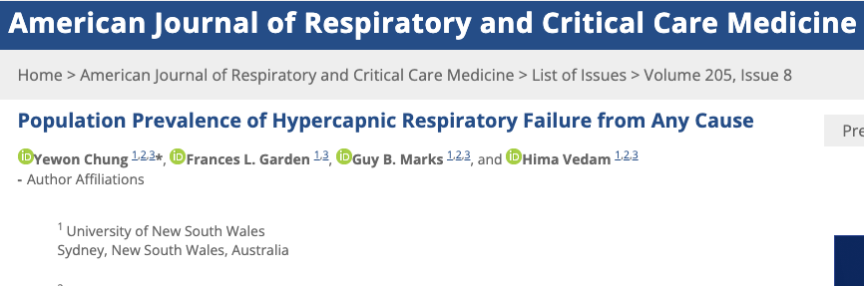
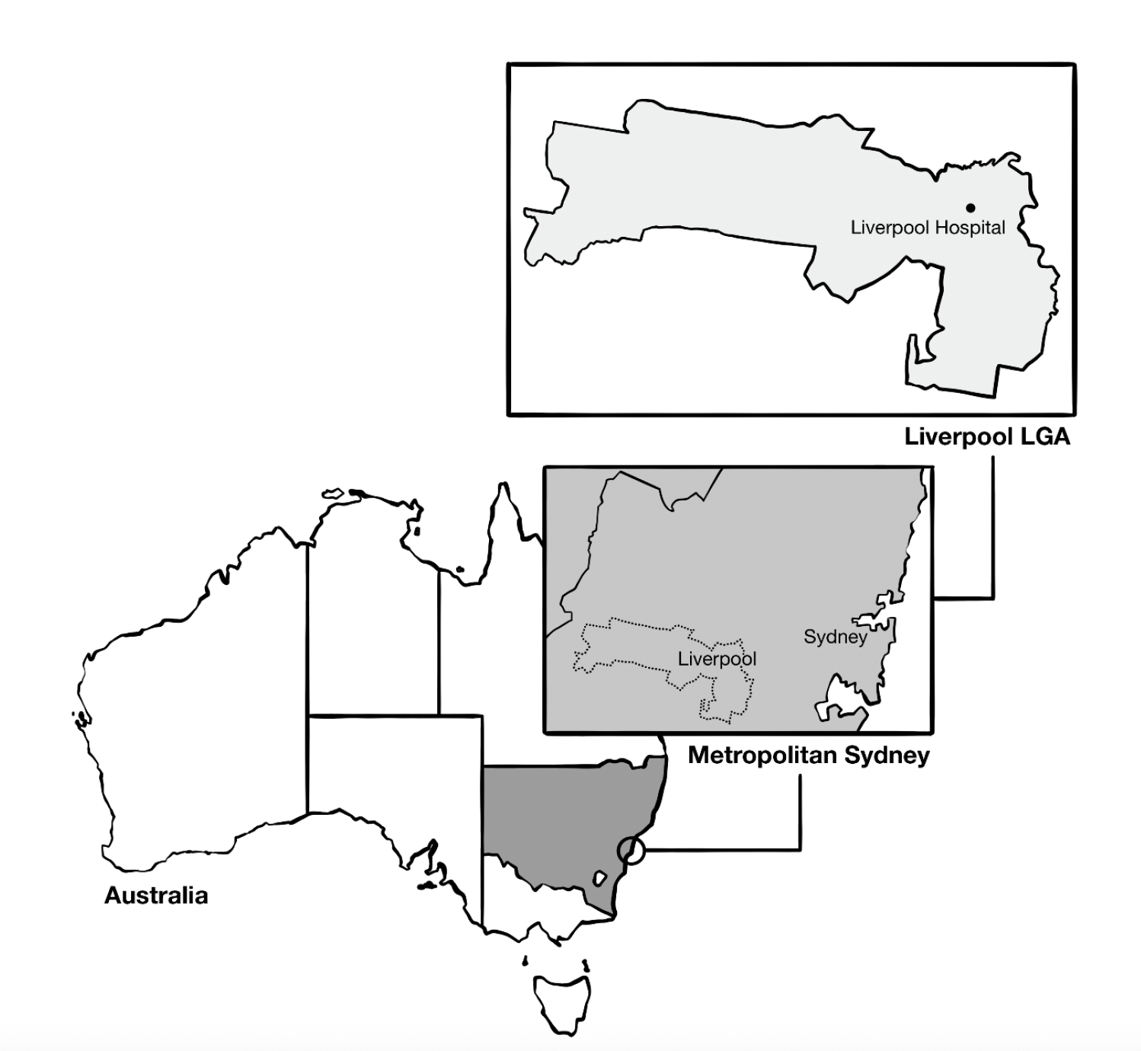
Hypercapnic Respiratory Failure is Common
Population-standardized period prevalence of PaCO₂ ≥ 45 mmHg (excluding iatrogenic causes):
150* per 100,000 person/year
Reference: Decompensated Cirrhosis 94.9 (US, 2017) per 100,000 person-year
Notes:
How common is hypercapnic respiratory failure?
— Chung et al estimate -

Slide 11
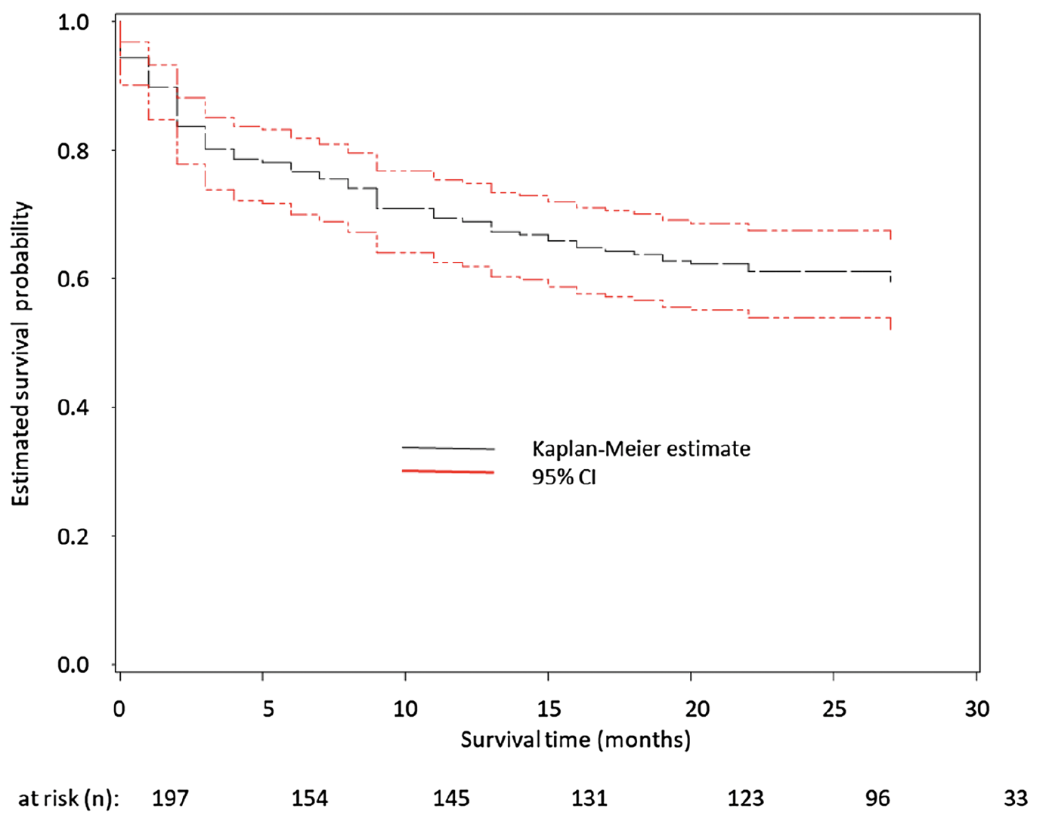
Hypercapnic Respiratory Failure is Prognostically Important
Inpatient ICD code for Hypercapnic Respiratory Failure @ U of VT
23% 30d readmission rate
Same as CHF, more than MI
Usually (66%) with recurrent hypercapnia
Notes:
What are the consequences of having hypercapnic respiratory failure?

Slide 12
DIAGNOSIS
Don’t Miss It,
Don’t Misattribute It
1 Hypercapnia hides behind hypoxemia — especially at our elevation
2 “COPD” and “asthma” labels are often wrong — verify before you trust

Slide 13
How to Spot It: Clinical Screening Pearls
Red flags that should trigger workup
Unexplained hypoxemia in an obese patient
Elevated serum bicarbonate (HCO₃), ? compensation for chronic CO₂ retention
Recurrent “COPD/Asthma/HF exacerbations” without credible diagnostic support
Clinical approach
Obtain a ABG or VBG confirm hypercapnia (*we’ll talk device qualification later)
Skeptically evaluate for “explanatory” causes (true COPD, asthma, CHF)
Many patients have multiple contributing conditions: obesity is often one of them

Slide 14
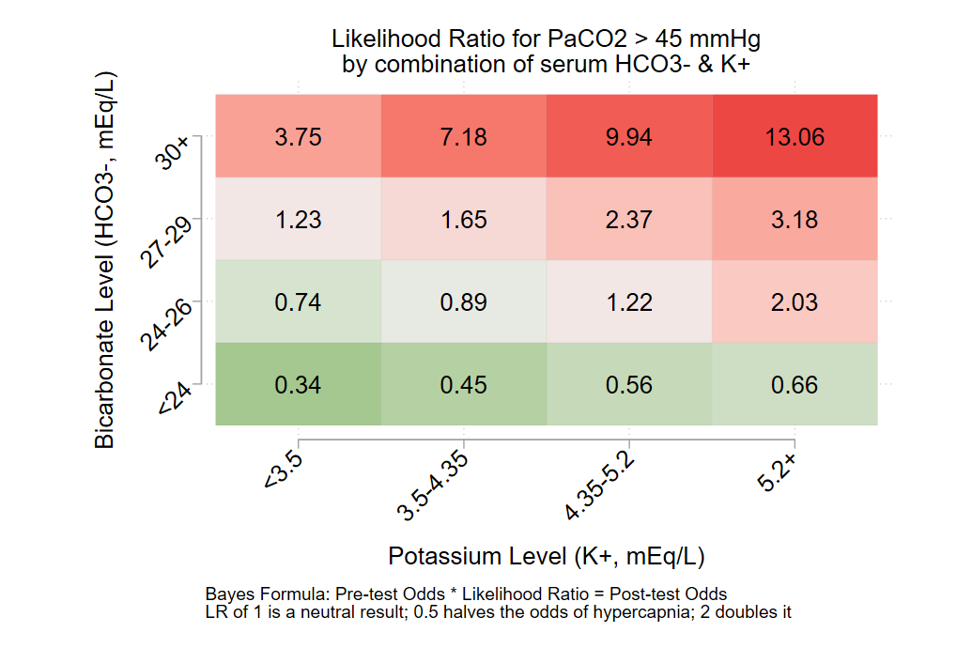
Using HCO₃⁻ and K⁺ to Identify Hypercapnia
Figure 3: Joint Interval Likelihood Ratios
Interval Likelihood Ratios
HCO₃⁻ alone (any K⁺):
<24: LR ~0.5 (halves odds)
24–26: LR ~1 (neutral)
27–29: LR ~2 (doubles odds)
≥30: LR ~9 (strong evidence)
K⁺ shifts LR by 3–3.5×
HypoK → less likely hypercapnia
HyperK → more likely hypercapnia
Locke et al. N=870,019 in nationally representative EHR data (TriNetX, 75 U.S. health systems, 2022); 203,399 with paired ABGs & BMPs; 32% hypercapnic.

Slide 15
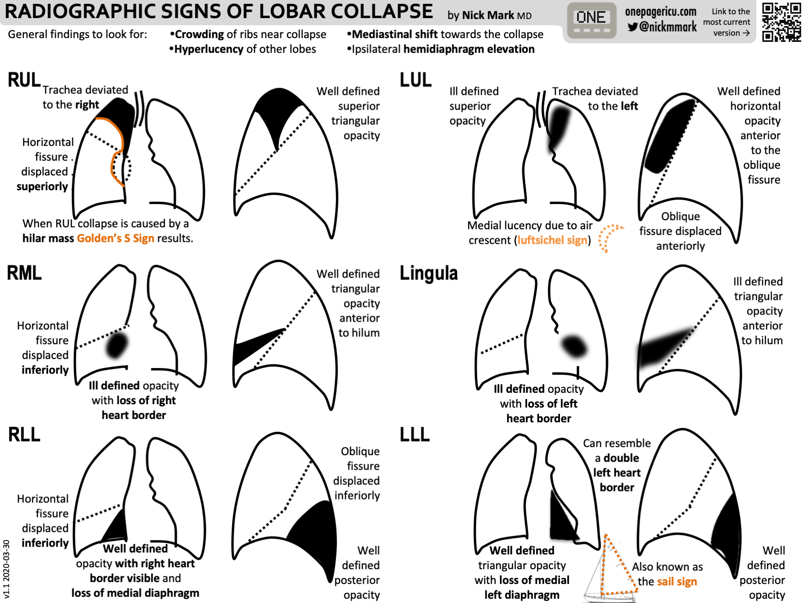
It's Often Not Just Hypercapnia
OHS itself causes:
Hypercapnia
Subsequent mild, correctable hypoxemia
But the obesity also causes:
Atelectasis (esp. LLL & RLL)
Observable on CXR (see patterns →)
Shunts blood → much more refractory hypoxemia
Abdominal adiposity compresses the lower lobes — looks almost normal on CXR but the shunt fraction can be significant

Slide 16
DIAGNOSIS › Goal 2
Don’t Misattribute Hypercapnia
Missed diagnoses of “COPD” and “asthma” are common.
Most pre-existing diagnoses are inaccurate — only trust what you can verify.
✓ Goal 1: Don’t miss hypercapnia

Slide 17
Misdiagnosis Pitfalls in Obese Patients
"Asthma" in the obese patient
Dyspnea + wheeze + obesity ≠ asthma; β-agonists / steroids prescribed empirically
Tricky — obesity IS a real risk factor for asthma, and asthma IS a hard diagnosis
Do symptoms vary day-to-day? Triggered by exposures? Substantially resolved with ICS?
"COPD" in the obese patient
If no PFTs, do they have a reason for COPD? (smoking?)
Do they have emphysema?
Disjunctive Syllogism (Process of Elimination)
"When you have eliminated the impossible, whatever remains, however improbable, must be the truth."
— Sherlock Holmes, The Sign of the Four
In practice:
If hypercapnia is confirmed, something caused it. If workup fails to support COPD, asthma, CHF etc… the remaining suspect (OHS) becomes the working diagnosis.

Slide 18
Low diagnostic testing rates
Testing for most common causes of hypercapnia (e.g. spirometry, sleep testing) occurs after hospitalization.
Diagnostics require special resources, referrals, and high patient engagement; barriers may reduce workup completion rates.
Workup should, presumably, include tests for the commonest causes.
Identified Hypercapnia
Appropriate diagnostic testing
± Qualification for treatments
Effective management

Slide 19

How Often Does Testing Actually Happen?
CO₂-PATH (Post-Acute Trajectories of Hypercapnia) Cohort
Utah All-Payer Claims Database: all hospitalizations statewide, 2015–2019
Identified patients with hypercapnic respiratory failure by ICD-10-CM codes
Notes:
Hege makes the point about opiates – open question how much of a population impact this has on CHRONIC respiratory failure – for e.g. https://pmc.ncbi.nlm.nih.gov/articles/PMC10503117/ suggests not so much.
We are looking at this in the CO2-PATH cohort.

Slide 20
DIAGNOSIS › Recap
✓ Don’t miss hypercapnia
At SLC elevation, even mild PaCO₂ elevation → hypoxemia. Atelectasis adds shunting on top.
✓ Don’t misattribute hypercapnia
“COPD” and “asthma” labels in obese patients are often wrong. Skeptically evaluate, not empiric treatment.
Next: What can we do about it?

Slide 21
Why is the discharge management so hard?

Slide 22
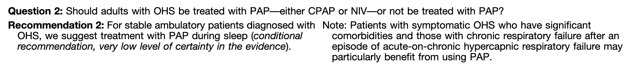
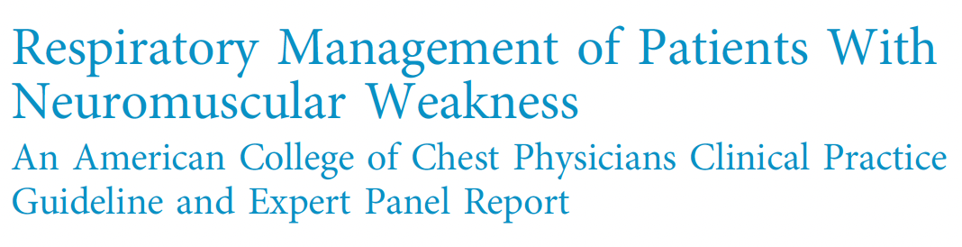
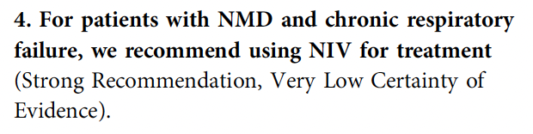
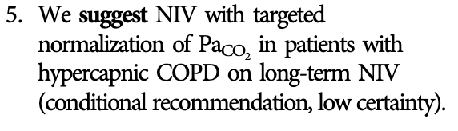
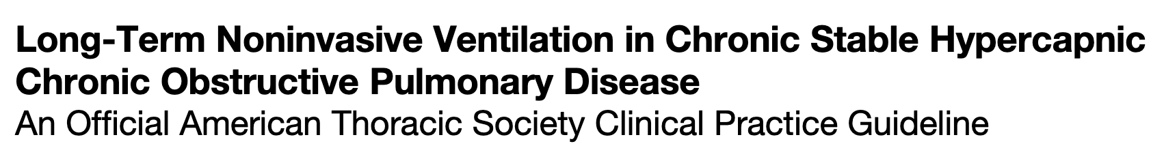
Therapeutic options exist:

Slide 23
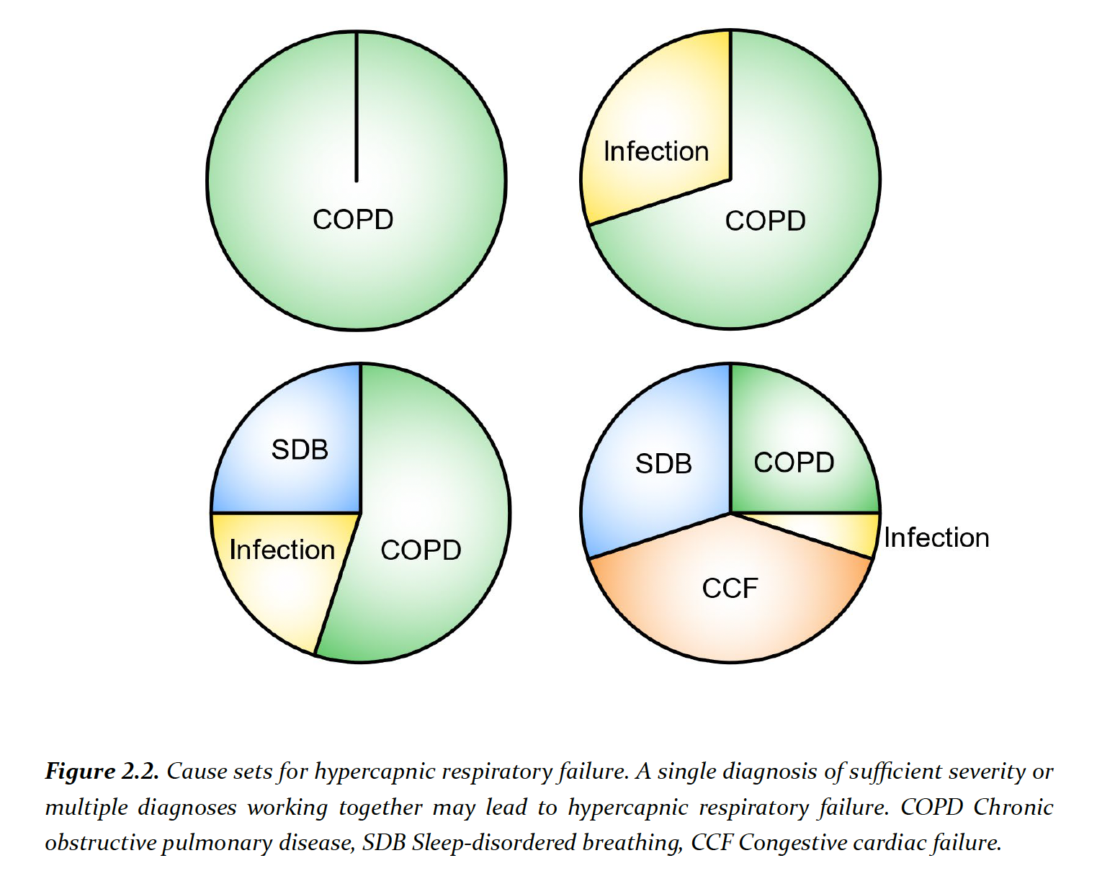
Two problems:
1. Patients in real life often have multiple contributing causes for their hypercapnia
All Recognized Cases
(Multifactorial Causes,
Relapsing-Recurrent)
???
Chronic ↑CO₂ COPD
Obesity Hypovent
ALS

Slide 24
Two problems:
2. Hypercapnic respiratory failure often precedes diagnosis of the causative disease
Outpatient Diagnosis
Disease Worsens or exacerbates
Hypercapnic Resp. Failure
Stabilized
Management as per guideline
No established Diagnosis
Presentation with hypercapnia
Stabilized; outpt. workup ordered
Initial outpt. management?
Transition in care
Reliable?

Slide 25
The Discharge Paradox
ATS Guidelines (strong* recommendation [the evidence isn’t actually strong]):
Discharge with empiric NIV in hospitalized patients with OHS
Reality:
No such thing as a "loaner" BPAP - forbidden
Qualification requires testing that takes days to weeks, who owns
Patient goes home on O₂ alone — or doesn't go home at all. Not
The evidence says "send them home with BPAP" — the system says "you can't."

Slide 26
Post-discharge diagnostic workflow: many opportunities to de-rail
HMV / DME
Discharge
after
Hyper-
capnia
Prescribe HMV*
DME Receives
Order
RT Setup &
Education
Ongoing DME
Mgmt
Pulmonary
Refer to
Pulmonary
Schedule
Pulm Appt
PFTs Before
Visit
Discuss w/
Pulm Provider
Sleep
Order Sleep
Referral
Sleep Appt
Scheduled
In-lab PSG
Completed
Discuss w/
Sleep Provider
Cardiology / Neuro / Other
Referral
Placed
Specialist
Workup
Consultation
Complete
⚠ Referral may not be placed
⚠ Special resources required
⚠ No single pathway owner
⚠ Lost to follow-up
So what can you do?
Call or message me
(or JB in U of U setting)
Consultative service
To clinic referral
Pulm disease navigator (future)
Owns the full pathway

Slide 27

How Did We Get Here?
1940s–50s
CO₂ retention physiology first described during polio epidemics. Coma was "cerebrelia" — thought to be viral encephalitis — actually hypercapnic respiratory failure.
Persistent severe hypercapnia is only possible since supplemental O₂
1960s
Polio survivors need lifelong ventilation → March of Dimes respiratory centers (iron lungs). Centers close in 1960 (funding crisis).
1970s
Care transfers to CMS → trach + home mechanical ventilators become norm. National Coverage Determination written for their use (not anticipated to last).
Notes:
Each breath with a higher PaCO2 will contain more CO2 particles -> more efficient ventilation with higher blood CO2.
Ventilation is metabolically expensive- why not operate at a higher set point?
Hint: what is the evolutionary advantage of the goal PaCO₂ being lower in SLC (~33 mmHg) than sea level?
Consider: why does permissive hypercapnia work? (higher VE VCO2)
The mere existence of chronic hypercapnic respiratory failure tells you its not immediately fatal.
Chronic can occur if: The ventilatory control system has decided to tolerate a higher PaCO2, either because the feedback mechanisms aren’t working (opiates) or it’s suboptimal to try to defend the CO2 level (ie. metabolically expensive – severe COPD or OHS)

Slide 28
1981–Present: CPAP → Convergence → Regulatory Split
1981 CPAP invented for OSA → later adapted as BPAP for other conditions
1990s HMVs, hypoventilation devices, and SDB devices converge technologically
1998 CMS creates "Respiratory Assist Device" (RAD) category to avoid tsunami of requests for home ventilators; NCD written
2025 Same 1998 NCD still governs BPAP qualification
The regulatory distinction today:
PAP devices = treatment for sleep apnea; either constant or bilevel
RADs = bilevel devices ± backup rate; evolved from CPAP
HMVs = evolved from hospital ventilators; designed as life-support
Each got its own National Coverage Determination with distinct qualification pathways despite technological convergence

Slide 29
Home NIV Devices: RAD vs. PAP vs. HMV
 | PAP for Sleep Breathing | RAD | HMV
What it is | CPAP / BPAP (for OSA / SDB) | Bilevel PAP ± backup rate (for hypoventilation) | Home mechanical ventilator (life-support)
HCPCS | E0601 (CPAP) E0470 / E0471 (BPAP) | E0470 / E0471 | E0465 / E0466 / E0467
Examples | CPAP, AutoPAP, BPAP (AirSense, DreamStation) | BPAP-ST, VAPS (Aircurve ST, Luna G3) | Trilogy, Astral, VOCSN
Max pressure | ~20–25 cmH₂O | ~25–30 cmH₂O | ~50–60 cmH₂O
Qualification | Diagnostic Sleep Study (PSG or HSAT) | RAD NCD pathway: diagnosis + clinical criteria | Clinician attestation + qualifying diagnosis
Payment | Rent-to-own (13 mo) | Rent-to-own (13 mo) | Monthly rental (indefinite)
Home RT | No | No | Yes — included in FSS
Key difference | Most common device; streamlined pathway | No home support after purchase | All-inclusive: device + supplies + RT visits

Slide 30
Where Does the Money Come From?
HMVs: Frequent and Substantial Servicing (FSS) payment
Monthly rental — all-inclusive: device + supplies + maintenance + home RT services
Payments continue indefinitely (no rent-to-own)
RADs and PAP devices: Rent-to-own (capped rental)
13 months of rental → ownership transfers to patient
No home RT support, no ongoing supplies coverage
The scale:
Medicare NIV charges reached $424.4 million in 2018
OIG found CMS overpaid ~$86.6M on HMV (E0466) vs. non-Medicare rates (2016–18)
Current Medicare guidelines do not reflect modernization that other payers and countries have employed.

Slide 31
Prior National Coverage Determination: HMVs
Patient has a NMD, Thoracic Restrictive Disease, or Chronic Respiratory Failure from COPD
Where “the condition is life-threatening where interruption of respiratory support would quickly lead to serious harm or death.”
Unlike RADs, no definitions of medical conditions or what constitutes life-threatening were given
Notes:
Use of a noninvasive ventilator in the home setting may be considered medically necessary when both of the following criteria are met (A. and B.):
A. The device is being requested to treat any of the following
Indications:
1. Neuromuscular disease
* 2. Thoracic restrictive disease
3. Chronic respiratory failure consequent to chronic obstructive pulmonary disease.
B. There is sufficient documentation in the medical record to support the condition is life-threatening where interruption of respiratory support would quickly lead to serious harm or death.
Il. Use of a noninvasive ventilator in the home setting is considered not medically necessary when Criterion I. is not met, including but not limited to the following situations:
﻿﻿﻿The patient's condition is such that treatment may be adequately provided by a bilevel positive airway pressure device
﻿﻿﻿Severity of the patient's condition is not severe and life-threatening.
There are no definitions for these medical conditions (Unlike the RAD criterion)
﻿﻿"Adequately provided by bilevel" is not defined in the E0466 NCD
• • ﻿﻿"Life threatening interruption" is not defined in the E0466 NCD

Slide 32
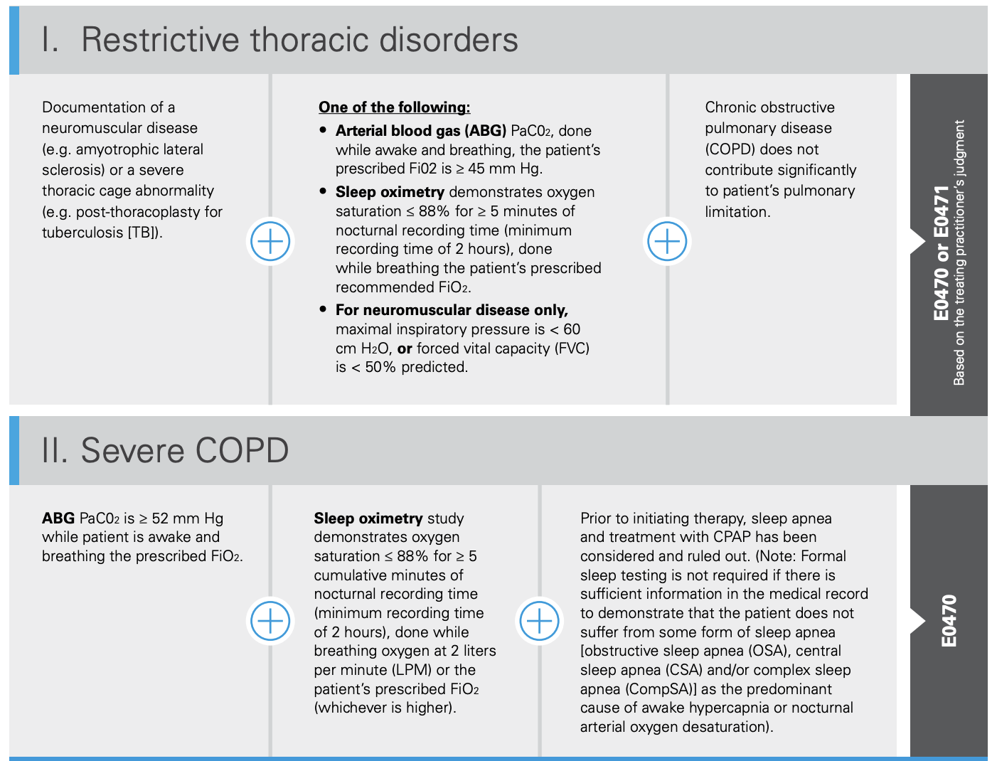
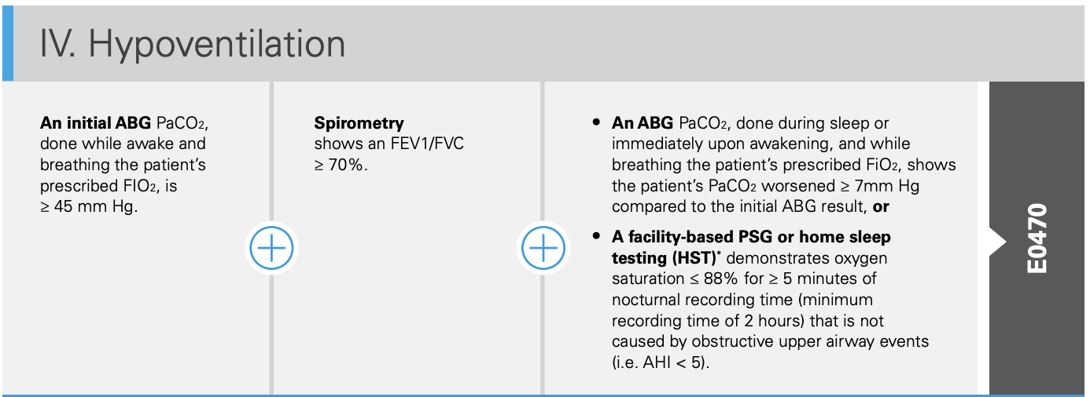
Old National Coverage Determination: RADs

Slide 33
The Qualification Maze
To qualify a patient for a RAD, the provider must:
1. Determine likely diagnosis: OSA, COPD, CSA, restrictive thoracic disease (NMD or thoracic cage abnormality), or hypoventilation
2. Proceed with focused testing for that specific diagnosis:
Polysomnography or home sleep apnea testing
Overnight oximetry
Spirometry
Arterial blood gas (PaCO₂)
The paradox:
The COPD pathway requires nocturnal oximetry – not clinically relevant (30 years old!)
The HMV NCD is so old and vague that it's often paradoxically easier to qualify for than a RAD ($$$)
These 1998 guidelines have not been updated to reflect the current evidence base, yet

Slide 34
What's Changing in the New Coverage Determinations for RADs?
NMD pathway: No change. | COPD / hypoventilation pathways: Updated below.
"COPD" — Outpatient | "COPD" — On Discharge
Chronic Respiratory Failure Dx ("COPD" includes all non-OSA hypercapnia) No PFTs required | Acute-on-Chronic Respiratory Failure Dx No PFTs required
PaCO₂ ≥ 52 mmHg 2+ weeks after hospitalization or without exacerbation of symptoms | Document full RAD settings within 24h of discharge
Sleep apnea is not the sole cause No PSG or overnight oximetry required | RAD needed to avoid symptoms or rapid PaCO₂ rise
Q6-month Continued Usage: confirm medically necessary, avg ≥5h/24hr usage, and improved CO₂, exacerbations, or symptoms
Notes:
COPD is more of a vibe than a diagnosis now. -> prepare for huge amounts of confusion about diagnosis (already a big problem)
COPD pathway includes ILD, overlap, etc. … basically everything that isn’t OSA and NMD

Slide 35
Section Take Home Points: Devices
01 Separate the mode from the purpose. All three device categories (PAP, RAD, HMV) can deliver BPAP — what differs is the clinical intent: treat sleep-disordered breathing, treat hypoventilation, or provide life support.
02 Prior sleep study? Use the PAP pathway. If the patient already has a diagnostic sleep study, you can often qualify them for the device functionality they need through the streamlined sleep PAP pathway.
03 Will they fail without a machine? Consider HMV. A home mechanical ventilator can be used at least temporarily — qualification is straightforward, though cost is higher with ongoing rental.
Everyone else? Navigate the RAD pathway. For patients without a prior sleep study who aren't acutely failing, you'll need the RAD NCD pathway.
Phone a friend.

Slide 36
Emerging Role of GLP-1 Receptor Agonists
Weight Loss Improves OSA
~0.45 AHI events/hr reduction per 1% body weight lost
Locke et al. Obes Rev. 2024; meta-analysis of 10 trials, n=854
SURMOUNT-OSA Trial (n=469; two phase 3 RCTs)
Tirzepatide: AHI −29.3 events/hr vs −5.5 placebo at 52 wk
Also reduced body weight, hypoxic burden, hsCRP, systolic BP
Malhotra et al. N Engl J Med. 2024;391(13):1193–1205
GLP-1 RA Benefit Depends on Causal Role of OSA in Hypercapnia
OSA found in 63–88% of ICU hypercapnic patients when sleep testing is performed (~5× the rate identified by clinician assessment)
Most patients with hypercapnic respiratory failure have an FDA indication for GLP1ra, but coverage challenging. (Unpublished work)
The extent that OSA is causal vs. epiphenomenal in many of these cases is not established
Locke, Brown, Sundar. Sleep Med Clin. 2024;19(2):339–356

Slide 37
What We're Learning — And What's Changing
Benchmarking the problem statewide
How often are patients with hypercapnic respiratory failure getting tested?
What are the readmission, ED return, and mortality rates across Utah?
Using Utah Population Database + All-Payer Claims (CO₂-PATH Cohort)
Moving toward risk-based (not diagnosis-based) referral
Expedite workup and empiric management for high-risk patients
Risk stratification via Select Health claims (AIM-HIGH project)
New NCD guidelines (2025) — finally modernizing RAD qualification
No longer requires PFTs for non-OSA hypercapnia qualification
Discharge pathway now has its own qualification track

Slide 38
Take Home Point
Obesity-related respiratory failure is common, morbid, under-recognized, and misattributed.
The diagnosis is hiding in plain sight — look for hypoxemia and elevated HCO₃ in obese patients with unexplained respiratory failure.
Regulatory and workflow barriers are real — but navigable.
Notes:
grant-making schema:
How big is the problem
How solvable is it?
How many people are working to solve it? (ie if we spend a bit more resources on this problem, will it make a difference?)

Slide 39
Summary
01 OHS is a diagnosis of exclusion. “Obesity-related respiratory failure” is a more practical clinical framework.
02 It is common, morbid, and under-recognized. Use hypoxemia and elevated HCO₃ to trigger workup. Attribute the cause via skeptical process of elimination.
03 Discharging on BPAP is hard: outdated NCDs, device categories, and payment structures create a qualification maze — but these are changing.
04 GLP-1 receptor agonists are an emerging tool — weight loss may improve or resolve the underlying respiratory failure, but data are sparse.

Slide 40






Acknowledgments
Scan for resources
Contact: brian.locke@imail.org | Epic/Teams Message (Intermountain)
Research Funding
Intermountain Foundation
ATS ASPIRE Fellowship
NIH/NHLBI T32 — University of Utah PCCM
Utah Population Database
U of Utah Huntsman Cancer Institute
NCI Cancer Center Support (P30 CA2014)
Clinical Support
Claire Davies & Megan Hepworth (PDNs)
Schmidt Chest Clinic
Collaborators
Intermountain Health
Ithan Peltan, MD MSc
Sam Brown, MD MSc
Holly Frost, MD PhD
Select Health
Rylan Fowers, PhD • David Hedges, PhD
Utah Population Database
Myke Madsen, MStat • Marie Gibson, CCRP
University of Utah
Ram Gouripeddi, MBBS MSc
Jeanette Brown, MD PhD
University of Arizona
Joseph Finkelstein, MD PhD
UC Davis
Krishna Sundar, MD

Slide 41
References
1. Wasserman K et al. Principles of Exercise Testing and Interpretation. Lippincott Williams & Wilkins. [Slide 1]
2. Berger KI et al. Mechanism of relief of tachypnea during pressure support ventilation. J Appl Physiol. 2000;88:257–264. [Slide 4]
3. Locke BW et al. Epidemiology of hypercapnic respiratory failure [original research]. Utah All-Payer Claims Database, 2015–2019. [Slides 10, 19, 24]
4. Locke BW et al. HCO₃ and K⁺ as screening markers for hypercapnia. N=870,019 (TriNetX, 75 US health systems, 2022). [Slide 14]
5. Locke BW et al. Weight loss and OSA severity: a meta-analysis. Obes Rev. 2024; 10 trials, n=854. [Slide 36]
6. Malhotra A et al. Tirzepatide for treatment of obstructive sleep apnea (SURMOUNT-OSA). N Engl J Med. 2024;391(13):1193–1205. [Slide 36]
7. ATS Clinical Practice Guideline. Evaluation and management of obesity hypoventilation syndrome. Am J Respir Crit Care Med. [Slide 25]
8. CMS National Coverage Determinations: RAD (E0470/E0471), HMV (E0465/E0466/E0467). [Slides 31–34]
9. OIG Report: Medicare overpaid ~$86.6M on HMV (E0466) vs. non-Medicare rates, 2016–2018. Medicare NIV charges $424.4M (2018). [Slide 30]
10. Utah Population Database (UPDB) & Utah All-Payer Claims Database (APCD). Statewide population-based data, 2015–2019. [Slides 19, 37]

